Slide 1

House Price Prediction
EDA and Machine learning modeling

Slide 2
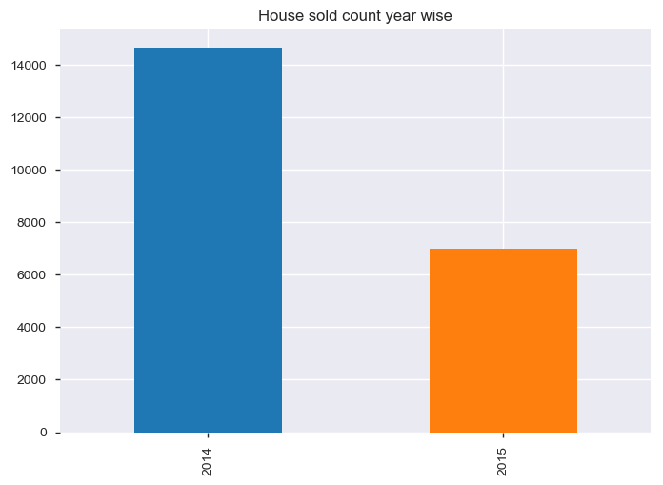
House sold count

Slide 3
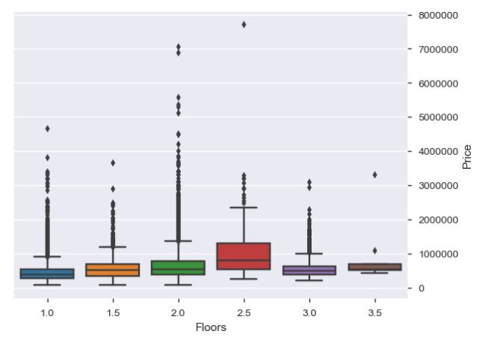
Floor Vs Price

Slide 4
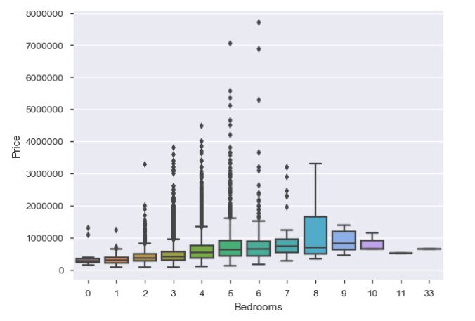
#Bedrooms Vs Price

Slide 5
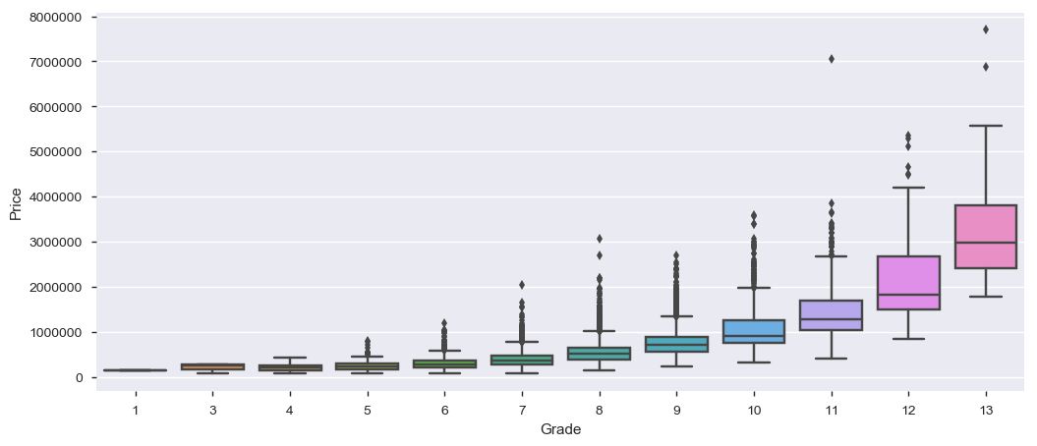
grade Vs Price

Slide 6
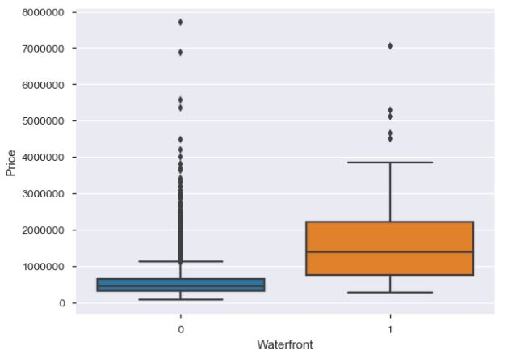
WaterFront Vs Price

Slide 7
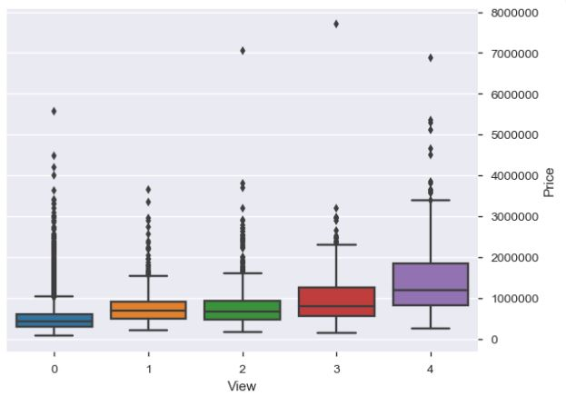
VIEW Vs Price

Slide 8
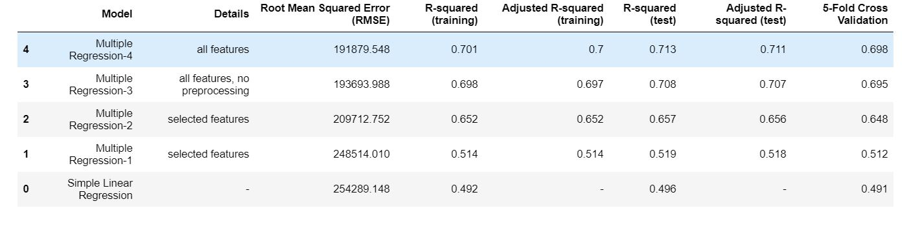
Evaluation: Linear vs multiple Linear Regression

Slide 9
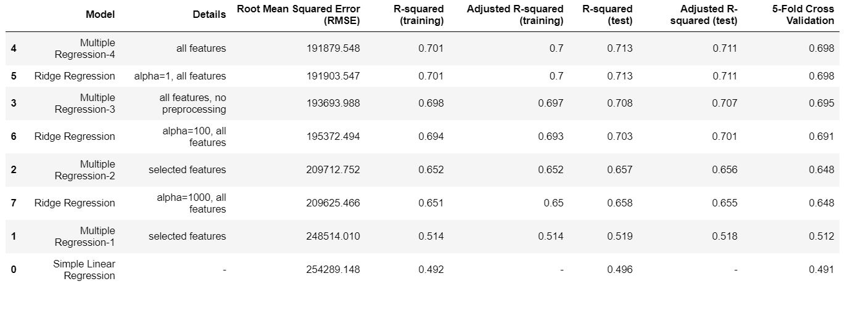
Evaluation: Linear vs multiple Linear Regression VS RIDGE REGRESSION

Slide 10
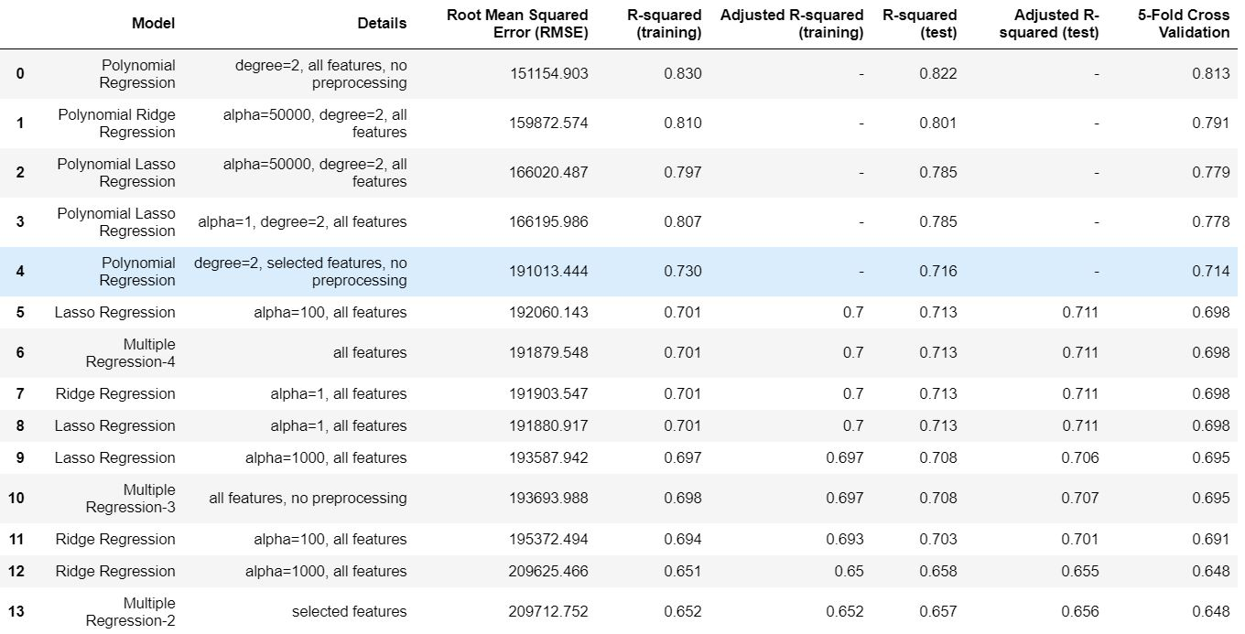
FINAL EVALUATION

Slide 11

Thank YOU

